Slide 1
Data Structures (Lab-7)
Complexity Analysis

Slide 2
Agenda for Today
What is Asymptotic Notations?
Code Analysis
Big-O
Omega
Theta

Slide 3
Asymptotic Notations
Big-O Notation (O-notation) Worst case
Omega Notation (Ω-notation) Best case
Theta Notation (Θ-notation) Average case

Slide 4
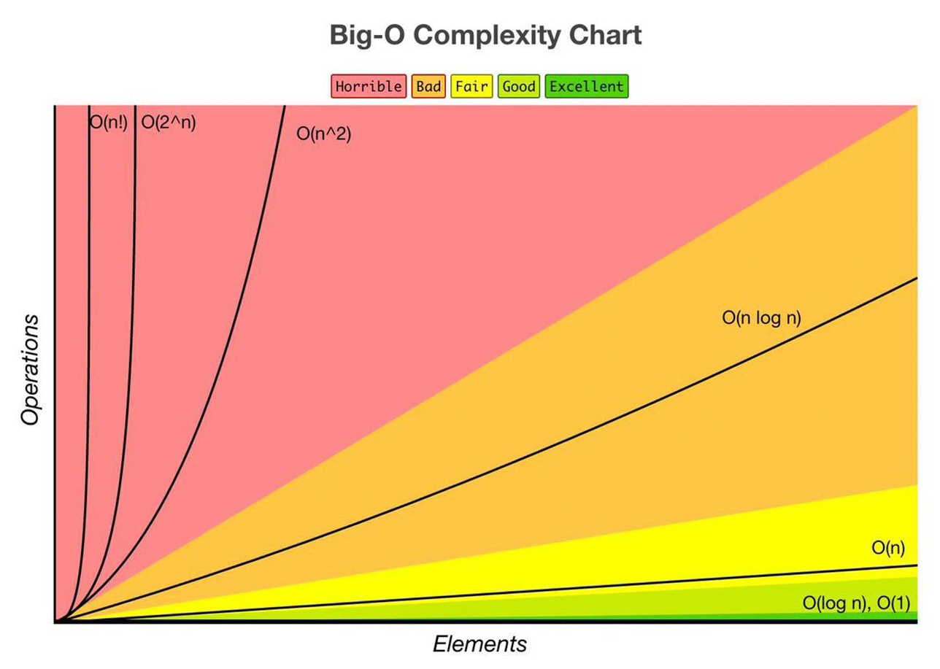
Big-O complexity chart
Big-O Chart: http://treeindev.net/article/algorithm-complexity-analysis

Slide 5
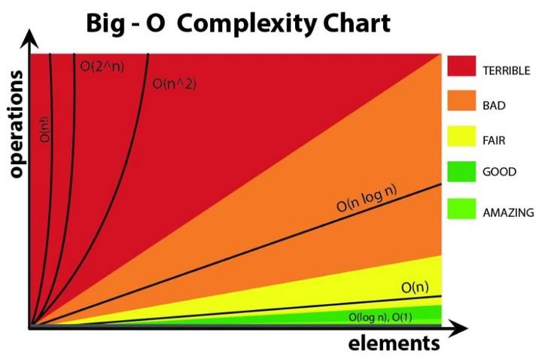
Growth orders
O(1) — constant time
O(log n) — logarithmic
O(n) — linear time
O(n²) — quadratic
O(2^n) — exponential
O(n!) — factorial

Slide 6
Example 1

Slide 7
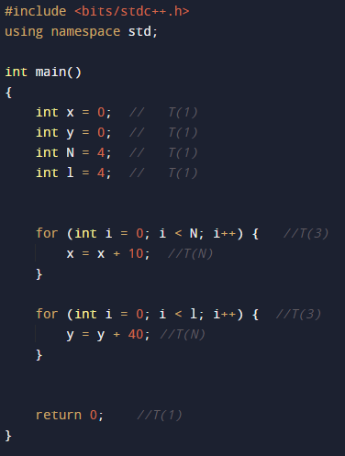
Code Analysis

Slide 8
Big-O Analysis
We have to deduce the Big-O complexity
To prove that: 1+1+1+1+3+5N+3+5N = O(n)
Solve for C=15 and No>=2
15N>=1+1+1+1+3+5N+3+5N
15N>=10+10N
O(n)

Slide 9
Omega Notation (Ω) Analysis
To prove that: 10+10N = Ω(n)
Solve for C=3 and No>=1
3N<=10+10N
Ω(n)

Slide 10
Theta Notation(Θ) Analysis
We have to deduce the Θ
To prove that: 10+10N = Θ(n)
Solve for C1=3 , No>=2 and C2=15
c1 .g(N) <= f(N) <= c2 .g(N)
3N<=10+4N<=15 N
Θ(n)

Slide 11
Example 2

Slide 12
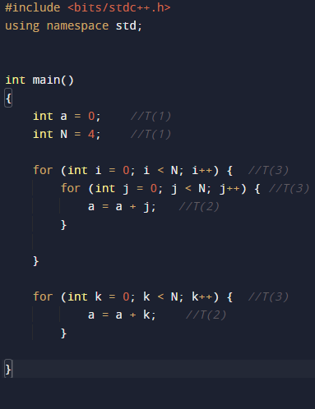
Code Analysis

Slide 13
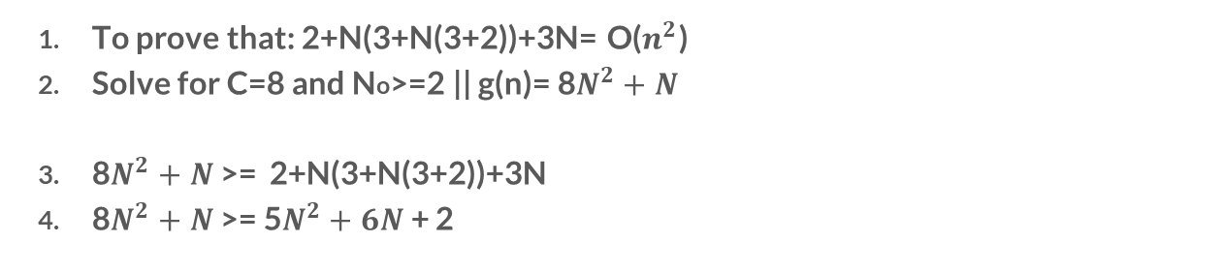
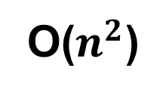
Big-O Analysis
We have to deduce the Big-O complexity

Slide 14
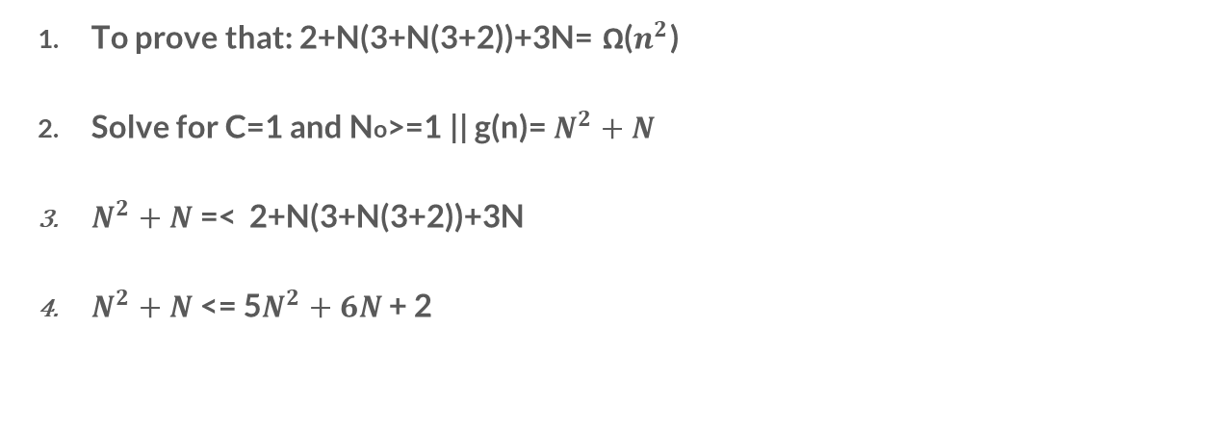
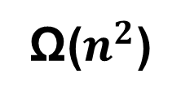
Omega Notation (Ω) Analysis

Slide 15
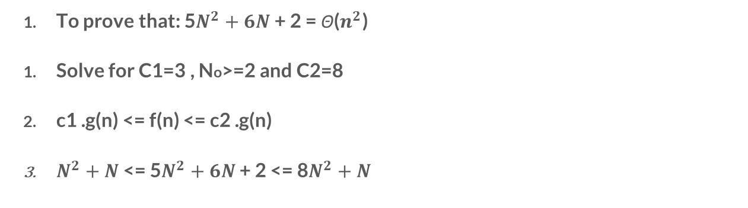
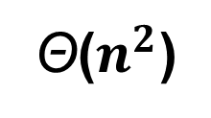
Theta Notation(Θ) Analysis
We have to deduce the Θ

Slide 16
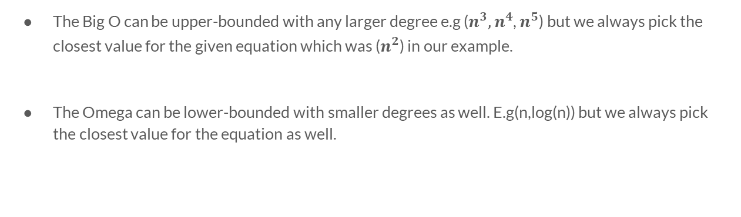
Note

Slide 17
Example 3

Slide 18
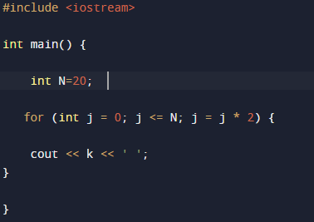
Code Analysis

Slide 19
Big-O Analysis
We have to deduce the Big-O complexity
g(n)=c1.f(n)=6+log(N) c1=6 No>=1
6+log(N)>=1+5 log(N)
O(log(n))

Slide 20
Omega Notation (Ω) Analysis
c1.g(n) = log(n) No>=1 c1=1
1+5 log(n) >= log(n)
Ω(log(n))

Slide 21
Theta Notation(Θ) Analysis
We have to deduce the Θ
log(n) <= 1 + 5 log(n)<=6+6 log(n)
c1=1 c2=6 No >=1
Θ(log(n))

Slide 22
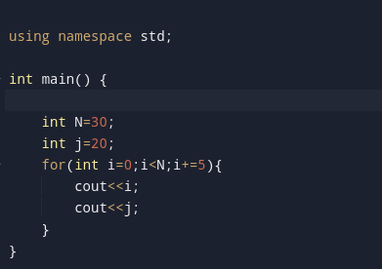
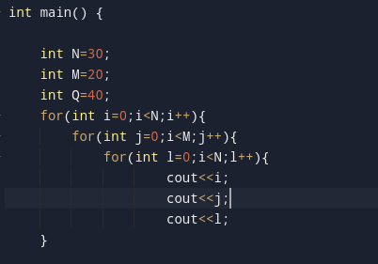
Task 1
Task 2
Analyze the code and calculate the asymptotic functions.
Analyze the code and calculate the asymptotic functions.

Slide 23
Thank you.

